Slide 1
The Sixth Form
at
Beths Grammar School
Mr Blyghton
Headteacher
Ms Adeoye
Assistant Headteacher

Slide 2
Excellence Community Respect
Beths Grammar School

Slide 3
Enjoyment of studying at a deeper level High aspirations for the next stage of learning Maximise academic potential here at the School Flourish into a well-rounded, confident, forward-thinking individual Development of thinking skills
Vision of the Beths Scholar

Slide 4
Courage to take academic risks Learn from your mistakes Be self-directed (5 hours, per subject, per week) Be comfortable with the unknown Develop you from GCSE students reliant on teachers into an adult with top A Level grades who is independent, self-motivated, unique and ready to move onto the next stage of their learning A Levels allow specialism and depth of understanding ready for university
Studying in the Sixth Form

Slide 5
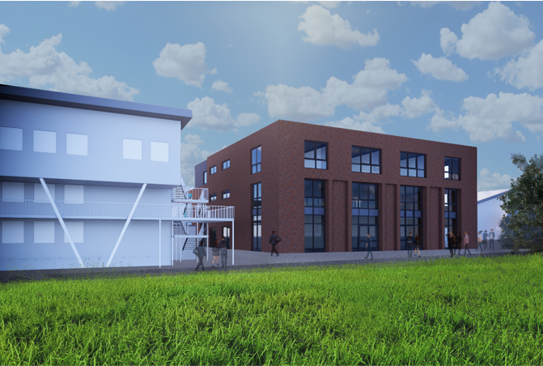
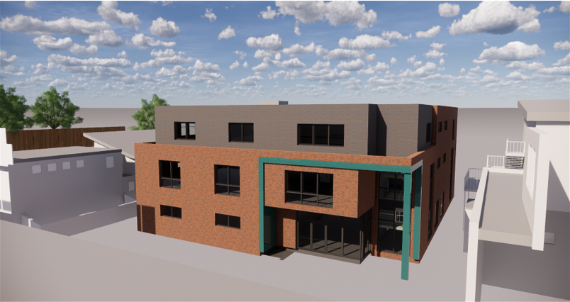
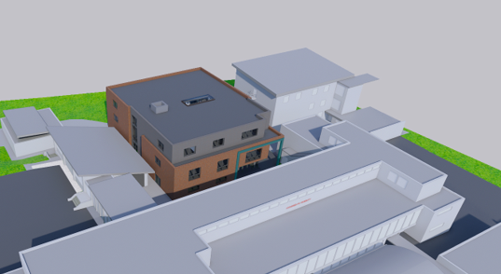
Building for the future Investing in our young people

Slide 6
Exceptionally popular both locally and regionally Around 700 students with students from a range of schools and areas We offer 30 different A Levels Average class size in the current Year 12 is 22 students Teacher time allocated during a timetabled cycle is 7 x 100 minutes Directed study is supervised (5 hours, per subject, per week)
Beths Grammar School Sixth Form

Slide 7
Pastoral education in both Year 12 and 13 Support Network in place SLT Head of Year Assistant Heads of Years across Years 12 and 13 Form Tutor School Counsellor Sixth Form Well-Being Champions (students) Individual Educational Needs support
Wellbeing

Slide 8
Subject Mentoring for younger Beths students Completing an Extended Project Qualification Completing a MOOC (Massive Open Online Course) Work Experience Completing a Duke of Edinburgh award Student led societies e.g. Multicultural committee Participating in Games and Sports fixtures Participating in School Concerts and Drama productions Debate club Multicultural committee Careers Talks LGBTQ+ society Academic lectures Prefect and House Captain teams Careers Talks Alumni
Personal Development

Slide 9
A dedicated team of careers specialists – three specialist staff Top Universities, Oxbridge and Medics Coordinator UCAS talks – Parents/carers and students University fairs University visits Apprenticeship fair Entrance exam and interview support 1-1 Personal statement support Dedicated tutor activities Trained Assistant Heads of Year for guidance in all areas Alumni
Next steps support – Beyond Beths

Slide 10
Top Performers 2024
Name | Grades achieved (subjects) | Destination
EB | Economics : A* ; Mathematics : A* ; Further Mathematics : A* ; Physics : A* | University of Cambridge : Economics
DF | Computer Science : A* ; Mathematics : A* ; Further Mathematics : A* ; Physics : A* | Imperial College : Computer Science (AI & Machine Learning )
AL | Computer Science : A* ; Mathematics : A* ; Further Mathematics : A* ; Physics : A* | UCL : Computer Science
VF | Computer Science : A* ; Mathematics : A ; Further Mathematics : A* ; Physics : A* | Imperial College : Computer Science (AI & Machine Learning )
VO | Economics : A* ; Politics : A* ; Sociology : A* | University of Cambridge : Human, Social & Political Sciences
JO | Biology : A* ; Chemistry : A* ; Mathematics : A* | University of Nottingham : Medicine
DB | Mathematics : A* ; Physics : A* ; Computer Science : A ; Further Mathematics : A | University of Oxford : Physics
MM | Mathematics : A* ; Physics : A* ; Chemistry : A ; Further Mathematics : A | University of Bristol : Aeronautical Engineering
TH | Electronics : A* ; Mathematics : A* ; Physics : A | Apprenticeship : Network Rail
BP | Mathematics : A* ; Physics : A* ; Chemistry : A | UCL : Computer Science
LP | Mathematics : A* ; Physics : A* ; Film Studies : A | University of Bristol : Mathematics
MS | Biology : A* ; Film Studies : A* ; English Literature : A | University of Bournemouth : Film Production
PT | Mathematics : A* ; Economics : A ; Further Mathematics : A ; Physics : A | University of Cambridge : Physics

Slide 11
Apprenticeships/careers
Jack C : Audit Apprenticeship with KPMG
Joy I : Audit Apprenticeship with KPMG
Matthew O : Audit Apprenticeship with KPMG
Ugonna O : Operations Apprenticeship with Goldman Sachs
at Queen Marys, University of London
Rasmus O : Civil Service with the DfE
at University of Kent
Max R : Building Surveying with Martin Arnold
at London South Bank University
Jess W : Engineering Apprenticeship with McGee
at University of west London
Tega E : Solicitor with Kesar at University of Law

Slide 12
Year 12 Induction day – Wednesday 25th, 26th, 27th June 2025 Results day and enrolment – Thursday 14th August 2025 September to November- Introduction, Developing good habits, Personal development opportunities December– First full report/Potential Oxbridge/Medics identified January onwards – Good habits established, building knowledge, engaging with supercurricular, Prefect selections June – Year 12 Trial Exams, UCAS predictions and UCAS workshops. Tailored support for Oxbridge/Medics. September - UCAS predictions finalised October– Oxbridge/Medics deadline for UCAS December – School UCAS deadline February/March 2026 – Year 13 Trial Exams August 2026– Results Day and support
Your next two years - a timeline

Slide 13
Online applications open - Thursday 21st November 2024 Ticketed open morning and afternoons (details to be posted on the website) Applications deadline – Friday 31st January 2025 Offers sent out – April 2025 Year 12 induction day – Wednesday 25th, 26th and 27th June 2025 Results day and enrolment – Thursday 14th August 2025
Applications and enrolment process

Slide 14
The Sixth Form
at
Beths Grammar School
Ms Adeoye
Assistant Headteacher
Mr Blyghton
Headteacher

