Slide 1
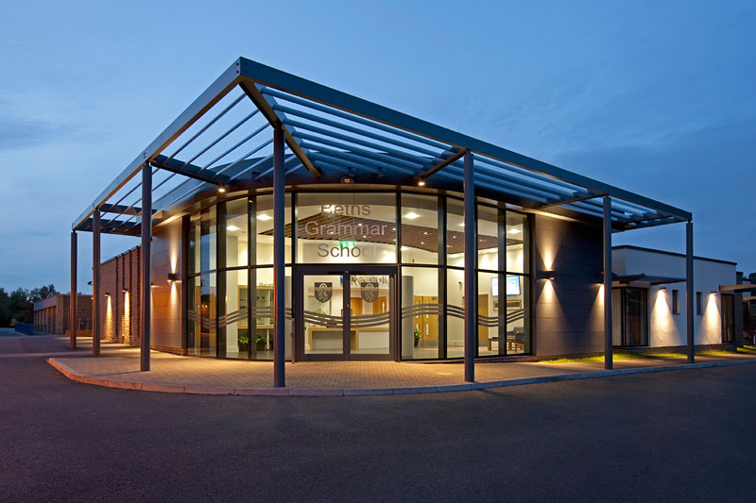

Sixth Form Bursary
Beths Grammar School

Slide 2
What is the Sixth Form Bursary?
The Government allocates funds to educational institutions to give to students who need financial help to stay in education.
Beths Grammar School has been given a fixed budget by the government which we will use to help those students overcome their individual financial challenges.
The Bursary is an annual award, paid to students in instalments
Students need to complete the application process and provide documentary evidence.
Notes:
Can we create a link on ‘application process’?

Slide 3
The types of bursary
Vulnerable Bursary – An award of up to £1,200 per year for those students defined as a vulnerable group (definition is in the policy document on the school website).
Discretionary Bursary - made at the discretion of the school and dependent on household income. Financial assistance will be provided for a specific educational purpose this can (see ‘What I can use the bursary for?’)
Notes:
Can I create a link to slide 5 on the last part?)

Slide 4
Am I eligible?
The criteria include:
You must be aged 16 or over but under 19 as at 31 August 2024 to be eligible for help from the bursary fund in this 2024-2025 academic year.
If you are aged 19 or over, you are only eligible to receive a Discretionary Bursary if you are continuing a study programme you began aged 16 to 18 OR have an Education, Health and Care Plan (EHCP)
If on post-16 enrolment form you have legally lived in the UK for the 3 previous years or have right of abode
You may be entitled if you were eligible for free school meals up to Year 11 you use this link to check if you should apply for Pupil Premium.
This is set out by the government and can be found here
Notes:
For web address was a shorter html link

Slide 5
You should complete a bursary application if you are:
In care
Leaving care
Receiving Income Support and / or Universal Credit
A disabled person in receipt of Employment Support Allowance (or Universal Credit) and Disability Living Allowance

Slide 6
What I can use the bursary for?
Bursary can be used to pay for or towards:
books,
Equipment that is essential for your course,
uniform,
transport,
field trips,
University interviews,
University Open Days
UCAS application fee
Some examination resit fees (only where you are still registered at school)

Slide 7
Does part time employment affect my eligibility and entitlement to the bursary?
NO
Part time employment is useful in helping you to develop important interpersonal skills and independence
However you should not be working more than 8 hours in a week as this will seriously affect your studies.

Slide 8
For further information / questions…
Email: bursary@beths.bexley.sch.uk
Visit:
Bursary section of the school website
Government guidance on the Gov.uk website
Notes:
To do – add link for Beths Policy document

Slide 9

Apply for the bursary
If you think you are eligible and therefore may be entitled to the bursary, please apply through this link:
https://bethsbursary.applicaa.com/1
Notes:
Add link for the Applica application.

