Slide 1
The Beths Scholar
What does it mean to be a Beths Scholar?

Slide 2
John Clough
Born on 13th October, 1928
His father was a manual labourer and his mother worked in a shoe factory
Went to a Wyggeston Grammar School for boys in Leicester
He enjoyed studying a range of subjects in school
Joined the Navy once he left school

Slide 3
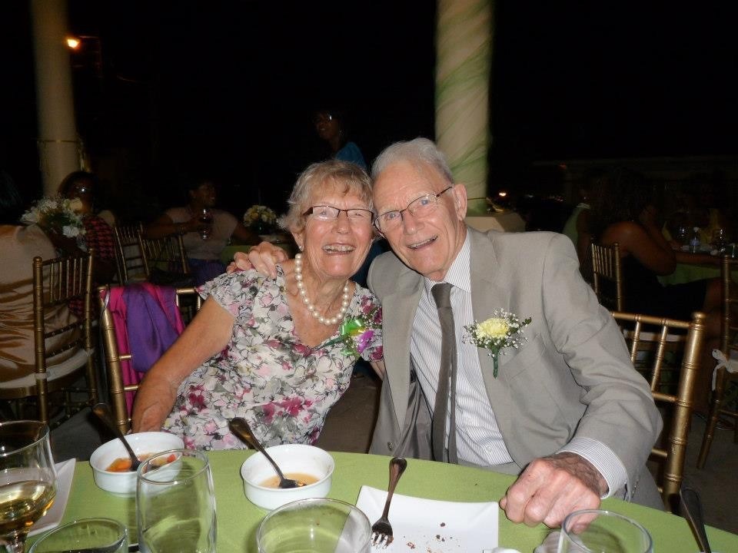
John Clough
Went back into education and studied to be an agricultural surveyor
Moved to Kenya to pursue his career and experience the world
Learnt to speak Swahili
Completed his German GCSE at 60 years old
Learnt how to use a computer at 80 years old

Slide 4
Being a Scholar
The definition of a scholar is someone who is passionate about learning. Scholars are dedicated and committed to their studies. They aim to be the best they can be and contribute positively to their communities.

Slide 6
The Beths Scholar
Excellent, Community, Respect
Willing to contribute to class or group discussions
Keen to know and find out more
Thinking hard and developing your own ideas and opinions
Resilient when you make mistakes
Kind and respectful to yourself and those around you
Prepared to go the extra mile

Slide 7
The Beths Scholar
Excellence
Community
Respect

