Slide 1

Year 9 into 10 GCSE Options 2025-27
Ancient History
Art and Design
Business
Chinese Mandarin
Computer Science
Design Tech
Drama
Economics
Electronics
Engineering
French
Geography
Geology
German
History
Italian
Music
Photography
PE
Psychology
RE
Sociology
Spanish
Statistics
Beths Grammar School

Slide 2
Curriculum Pathway (Core Subjects) Stage 1 – The compulsory subjects
It is compulsory that every student will study the following subjects;
Mathematics
English Language
English Literature
ALL three Science disciplines (Biology, Chemistry and Physics)
Running Total
6 GCSEs
All students will have lessons in PSHCE and Games however these will NOT be examined.

Slide 3
The English Baccalaureate (EBacc)
The EBacc refers to a combination of subjects that the Government thinks is important for young people to study at GCSE.
It includes:
English Language and Literature
Mathematics
2 Sciences
Geography or History
A Modern or Ancient Language
A study by the Sutton Trust reveals that studying the EBacc can help improve a young person’s performance in English and Mathematics.
Research by the UCL Institute of Education shows that taking the EBacc enhances prospects for entering further education or employment.

Slide 4
EBacc Choices
All students are strongly advised to study a Modern or Ancient Language
Chinese Mandarin
French
German
Spanish
Italian

Slide 5
Does Geology count towards the humanity aspect for EBacc?
No, Geology is not a humanities subject.
What languages count towards the language aspect for EBacc?
All modern foreign languages taught here at Beths. There are other languages too, which can be found using the following link:
https://www.gov.uk/government/publications/english-baccalaureate-ebacc/english-baccalaureate-ebacc

Slide 6
Option Choices
In addition to the 6 compulsory subjects, you need to choose 4 options subjects from the list below. You must also pick a reserve.
Ancient History
Art and Design
Business
Chinese Mandarin
Computer Science
Design Tech
Drama
Economics
Electronics
Engineering
French
Geography
Geology
German
History
Italian
Music
Photography
PE
Psychology
RE
Sociology
Spanish
Statistics
Running Total
6+4 = 10 GCSEs

Slide 7
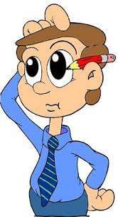
The Decision Making process
So where do you start?
Consider your future career aspirations
Consider your A Level thoughts (Check the sixth form website for requirements)
Look at university websites, do they have specific GCSE requirements?
You may not know exactly what job you want after education, but you may want to consider the type of industry you wish to go into.
Aim for a ‘broad and balanced’ range of subjects

Slide 8


Choose subjects that you ENJOY and that you are good at (look at your reports) | Do not let friends influence your decision – this is your future.
Ensure that the chosen subjects will hold your interest for 2 full years | Do not select subjects based on which teacher you think you will have
Read the assessment guidance on the options booklet – will you sit 100% written exams or are there controlled assessments? | There is no such thing as an ‘easy GCSE’.
Think about your current skills and consider if you think they are enough for the subject (e.g. Art, Drama, PE) | Do not opt for more than one creative subject, unless agreed with the Head of Subject.
Research careers, university courses etc. and speak to your teachers

Slide 9
Frequently asked questions
Can my child do more than 10 GCSEs?
We only timetable for students to complete 10 however some students do complete additional GCSEs (often community languages) externally.
We also very strongly discourage students from sitting GCSEs early externally as these rarely result in the grade the student would have got in Year 11.

Slide 10
What GCSEs should my child pick if they want to do X at University?
In short this depends on the course and the university. Look at the A level requirements for courses and work back from there.
Beths Grammar School - A Level Curriculum
Subject Choices booklet - here

Slide 11
Is there any preference over which students get which subjects?
We will aim to give all students their first 4 choices provided the option choices are submitted by the deadline of 2nd May.
We rarely need to use students’ reserve choices, but it can happen, so please think carefully about that.
Submitting the form early doesn’t change your chance of getting on that course.

Slide 12
Will my child do well in subject X? Will they have a certain teacher?
The skills needed for each subject are varied and the best person to speak to is the class teacher or Head of Department.
With regards to staffing we will not be assigning staff to classes until later in the year and staffing may change. This should therefore NOT be a factor when selecting subjects.

Slide 13
Can my child do multiple creative subjects?
Our aim at Beths is to produce a curriculum and experience that suits what your child enjoys and excels at. The short answer is therefore yes.
We would, however, caution that the creative arts require a huge time commitment and therefore doing multiple subjects could be somewhat exhausting.

Slide 14
How much homework will my child get?
This varies from subject to subject somewhat.
Up to about 90 minutes per night.
Each subject sets homework once (maybe twice) a week.
Will my child complete coursework?
Increasingly fewer subjects have a coursework component however there are still some.
This can account for up to 60% of the course.
Please look at the options booklet for course-by-course information.

Slide 15
My child does the MEP – how does this work for GCSEs?
With the MEP, students are on an accelerated pathway for Mandarin. As a result, we attempt to have them in a specific class for GCSE. This is effectively a ‘top set’.
Students who choose Mandarin but are not on the MEP are usually put in a group together to provide better support. These students also achieve exceptionally well.

Slide 16
How do you support students with specific SEND needs?
The staff at Beths always want to make sure we make the best decisions for our young people. In some cases, this means tailoring a curriculum to be more suitable for students with SEND. Please contact Mrs Blewett (K.BLEWETT@beths.bexley.sch.uk) directly to discuss any questions or concerns you may have.

Slide 17
Can you take more than 3 A levels (apart from those doing Further Maths)?
We do allow students to do 4 A levels outside of Further Maths (where they must do 2 additional A levels). However, we reserve this for students who attain top GCSE grades, usually well over an 8 average.
Very few universities offer based on 4 A levels so having 3 top grades is better than 4 good ones.

Slide 18
Are Humanities compulsory or optional? Can students study both?
Students are advised to study a humanity, although it is not compulsory.
Students can study both Geography and History should they wish.
Is RE compulsory?
RE is not compulsory. Much of the cultural and ethical content is covered within our PSHCE curriculum.

Slide 19
How many students do you need per subject to make it a viable course?
This is a difficult question to put a fixed number to and depends on several factors, however it is highly unlikely that a GCSE course would be considered on less than double figures.

Slide 20
Are there any restrictions to choices of A Level subjects if they have not been studied to GCSE Level?
Please see the Sixth Form Choices booklet via the attached link to check the requirements for each course (also on the next slide).
Beths Grammar School - Year 12 Admissions

Slide 21
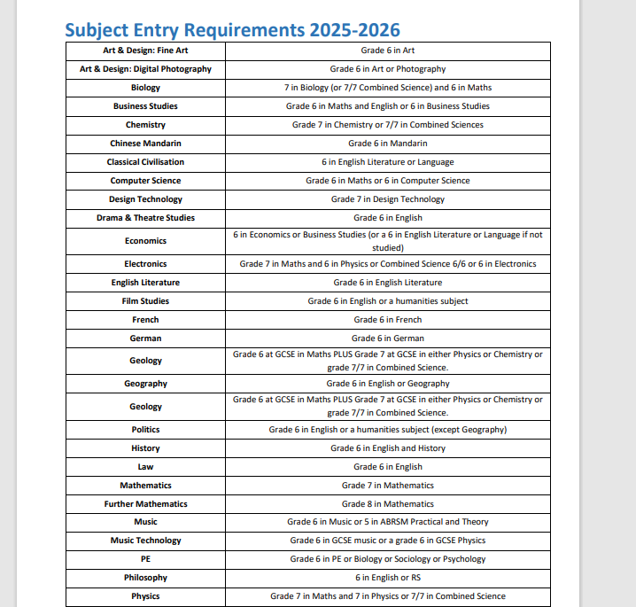

Slide 22
What do you need to do next?
Ensure that you have made FOUR choices plus a reserve.
Discuss with your tutor/Head of Year.
Speak to relevant Heads of Department/teachers if you’ve got questions.
Message them on Teams or email (addresses on website)
Complete the Options choices survey using the link in the Options booklet by 3pm on the 2nd May.

