Slide 1
Why English matters
What careers can you think of that use English?
Have you ever considered where studying English can take you?
Today, we’ll be exploring some of the career opportunities that are available to you, as well as the various pathways you can take to get there.
What do you think these roles involve (daily task, etc.)?
What skills do you think you might need for these roles?

Slide 2




Explore a career as a…
Junior Copywriter
Here are some example roles and careers linked to English
BBC Bitesize Video
Senior Content Executive
BBC Bitesize Case Study
N.B All roles and careers will involve application of what you are learning in English!
Notes:
Jobs that use English & Drama: BBC Bitesize Careers: https://www.bbc.co.uk/bitesize/tags/zfmnwty/jobs-that-use-english-and-drama/4
Activity Ideas:
Ahead of revealing content of slide, encourage students to think about as many roles linked to your subject as they can in pairs/groups
Encourage students to engage with specific videos/profiles or direct students to specific roles/careers to predict, research and reflect on:
Pathways
Essential Skills
Wages/Work Conditions
Why they might like/not like that role?

Slide 3



Solicitor
BBC Bitesize Profile
Personal Assistant
Here are some example roles and careers linked to English
BBC Bitesize Profile
Writer
BBC Bitesize Video

Slide 4



Where can English take you
Pathways at 16
Example Post 16 Routes
A-Level English Language A-Level English Language and Literature A-Level English Literature
BTEC Creative Media
T level Education & Childcare
Apprenticeship Ideas
Journalist
Public Relations Assistant
Speech & Language Therapist Advanced
Clinical Practitioner
Publishing Assistant
Customer Services Practitioner
Advertising and Media Executive

Slide 5

Where can English take you
Pathways at 18
Example Degrees:
English Language/English Literature
English and Comparative Literature
Creative Writing
English Studies and TESOL
Journalism
Law
Apprenticeship Ideas
Journalist
Public Relations Assistant
Speech & Language Therapist
Advanced Clinical Practitioner
Publishing Assistant
Customer Services Practitioner
Advertising and Media Executive

Slide 6




Here are three key skills needed for a career that uses English.
 | Video | Skills Builder Resource KS3 | Skills Builder Resource KS4
The oral transmission of information or ideas | Watch here | Short Lesson Speaking Step 6-8 | Short Lesson Speaking Step 8-10
The receiving, retaining and processing of information or ideas | Watch here | Short Lesson Listening Step 6-8 | Short Lesson Listening Step 8-10
The ability to set clear, tangible goals and devise a robust route to achieving them | Watch here | Short Lesson Aiming High Step 6-8 | Short Lesson Aiming High Step 8-10

Slide 7
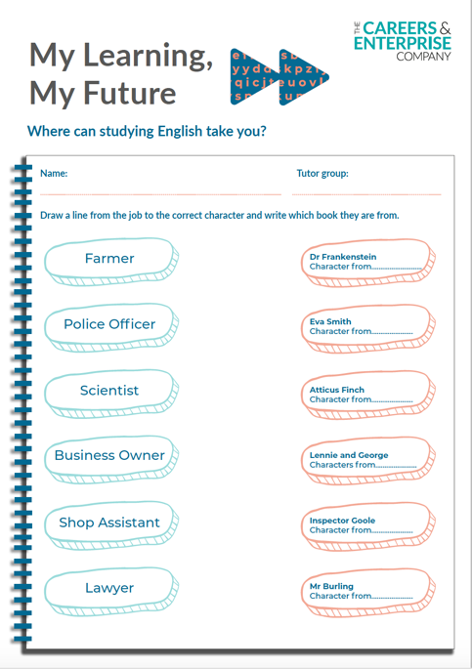

English Homework Task
Understand where English can take you by completing this exercise.

