Slide 1

Year 12 Work Experience
Beths Grammar School
Careers and Work Experience Department
Monday 29th June – Friday 3rd July 2026
Deadline to upload to Unifrog 2 March 2026

Slide 2
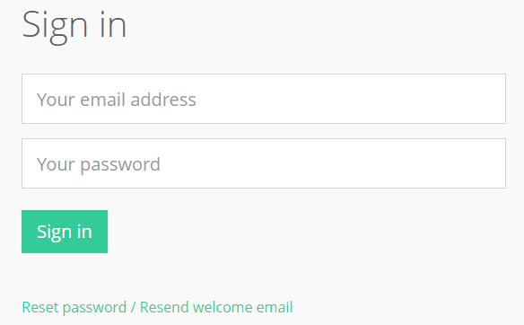
Sign in to Unifrog www.unifrog.org
Your email address is your school one.
If you can’t remember your password click the green Reset password / Resend welcome email.
Then log in to your school email account and follow the instructions

Slide 3
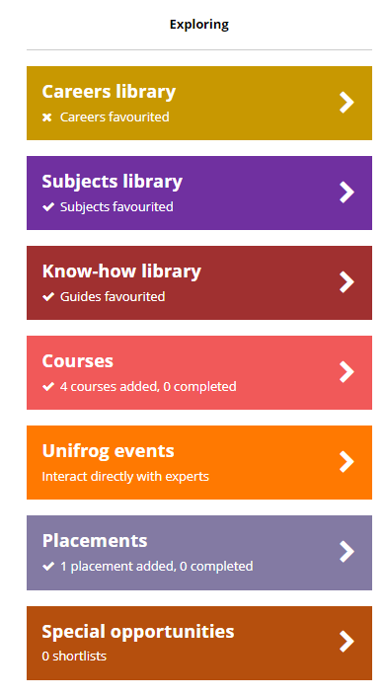
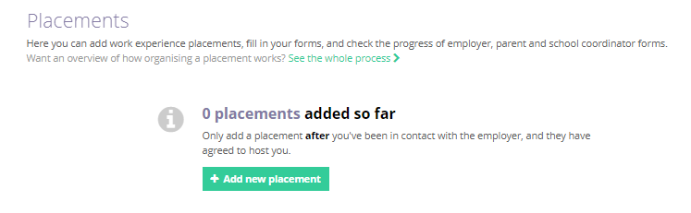
Once you’re signed in to Unifrog, scroll down to the Placements box under Explore Pathways
Click Go to tool and then + Add new placement

Slide 4
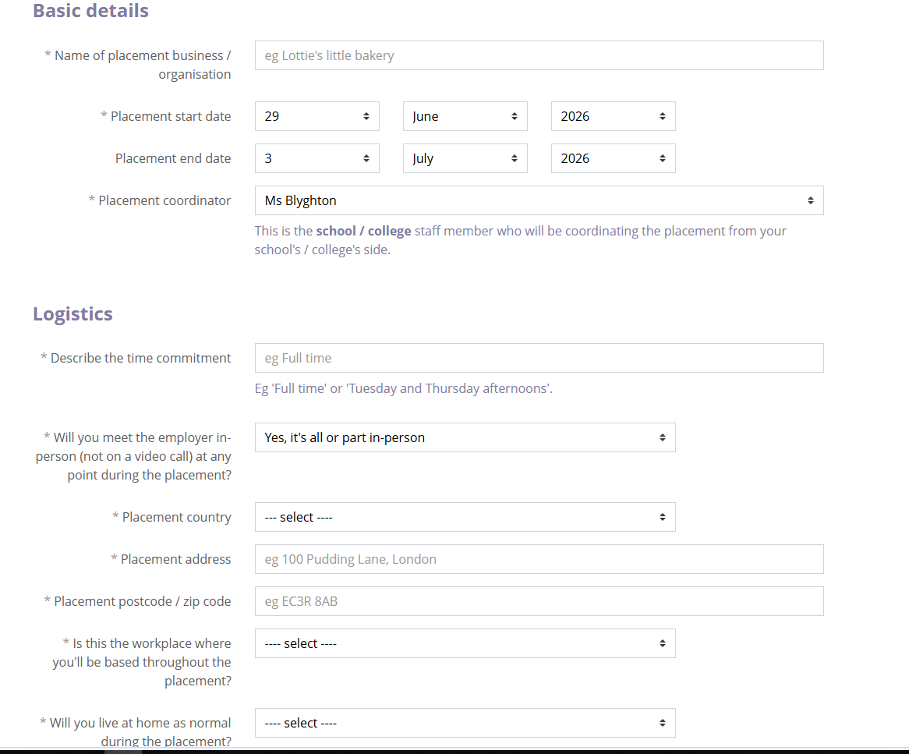
The name of your placement business 29 June 2026 3 July 2026 Ms Blyghton Full time (unless agreed otherwise with Careers) Placement address Will you live at home as normal during the placement (if you answer no, you will be prompted to give the address where you will be staying)

Slide 5
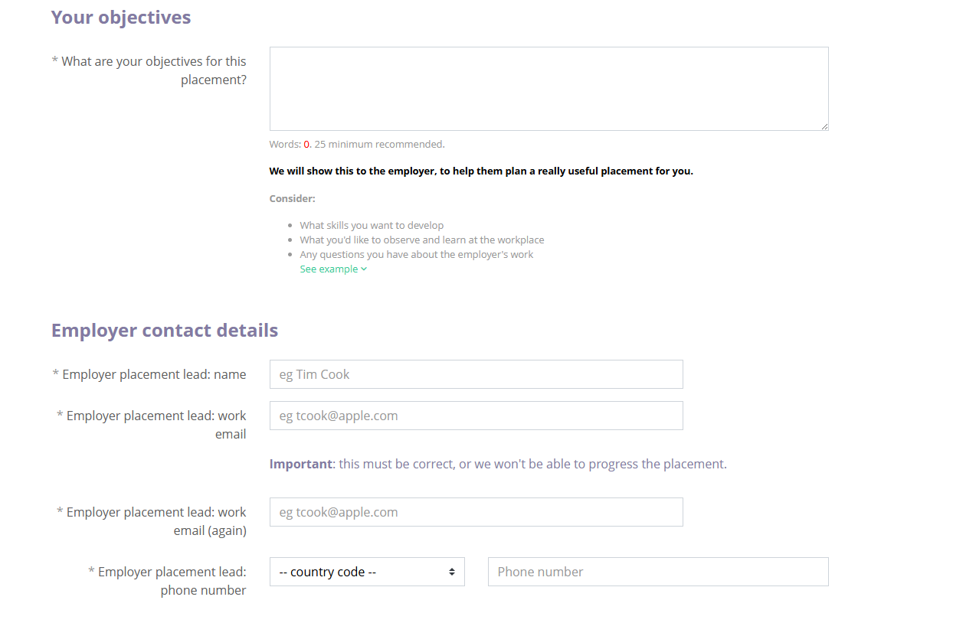
Objectives Employer placement lead name Employer lead email address Employer lead phone number

Slide 6
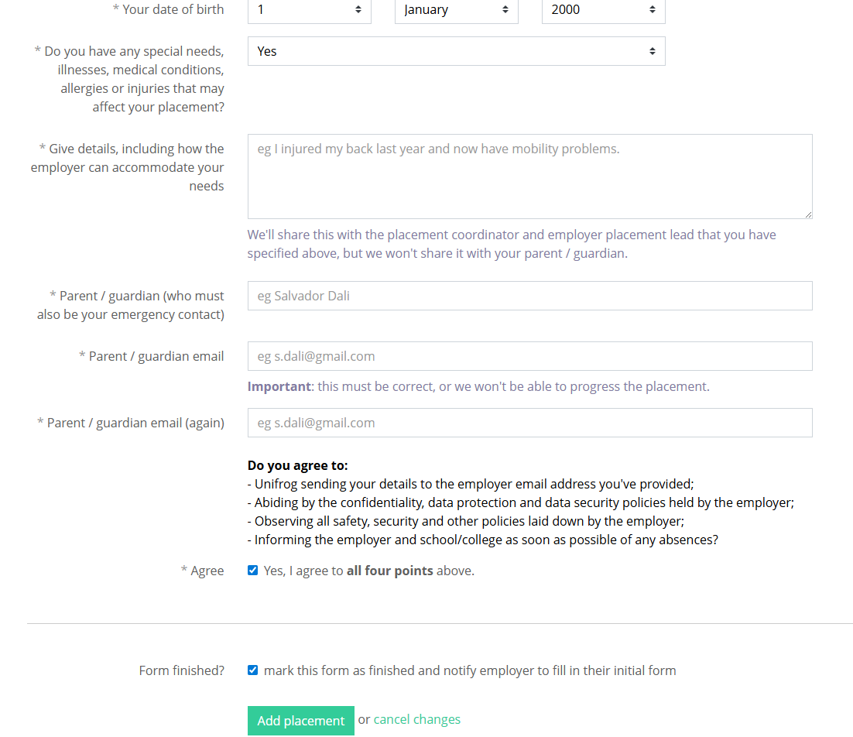
Your date of birth
Do you have any special needs, illnesses, medical conditions, allergies or injuries that may affect your placement?
Give details how the employer can accommodate your needs (if you've answered yes)
Parent/guardian (who must be your emergency contact)
Parent/guardian email
Do you agree to the four points (ask Careers if any questions)
Tick the box and Add placement

Slide 7

Useful contacts Careers: Ms Ratcliffe and Ms Rayneau Head of Year 12: Mr Parkes Head of Key Stage 5: Mr McBeth Your Form Tutor Subject teachers 6th Form AHOYs
For any queries, please email us:
workexperience@beths.bexley.sch.uk
Notes:
Allison

Slide 8

We look forward to an exciting Work Experience for all of our students!

